Slide 1
✅ PHASE VI: Database Interaction and Transactions
📌 Objective
Implement real-life DML/DDL operations with procedures, functions, exception handling, and packages.
📄 Tasks Performed
DML Operations: INSERT, UPDATE, DELETE
DDL Operations: CREATE, ALTER
Procedures Created: update_attendance_status
Functions Created: get_total_donations
Cursor Usage: Data retrieval
Exception Handling: For data safety
Packages: church_pkg for code modularity

Slide 2
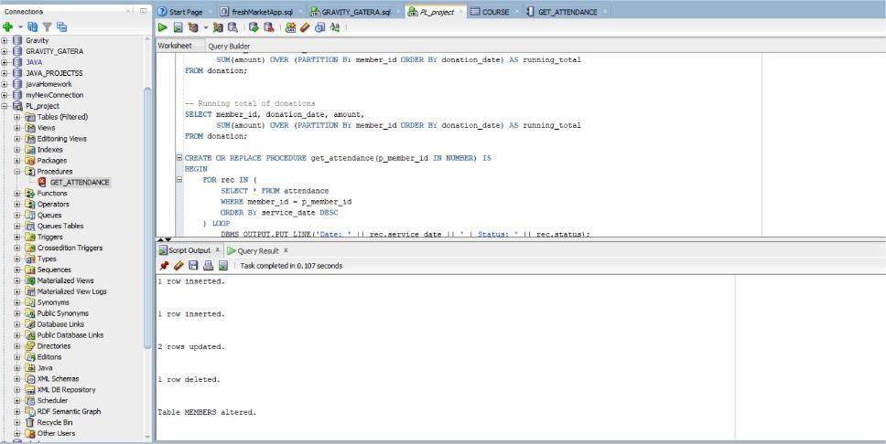
DML Operations: INSERT, UPDATE, DELETE

Slide 3
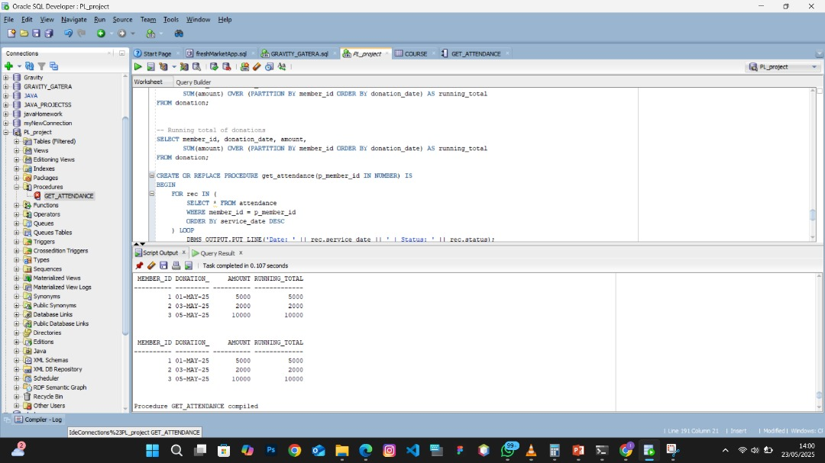
DDL Operations: CREATE, ALTER

Slide 4
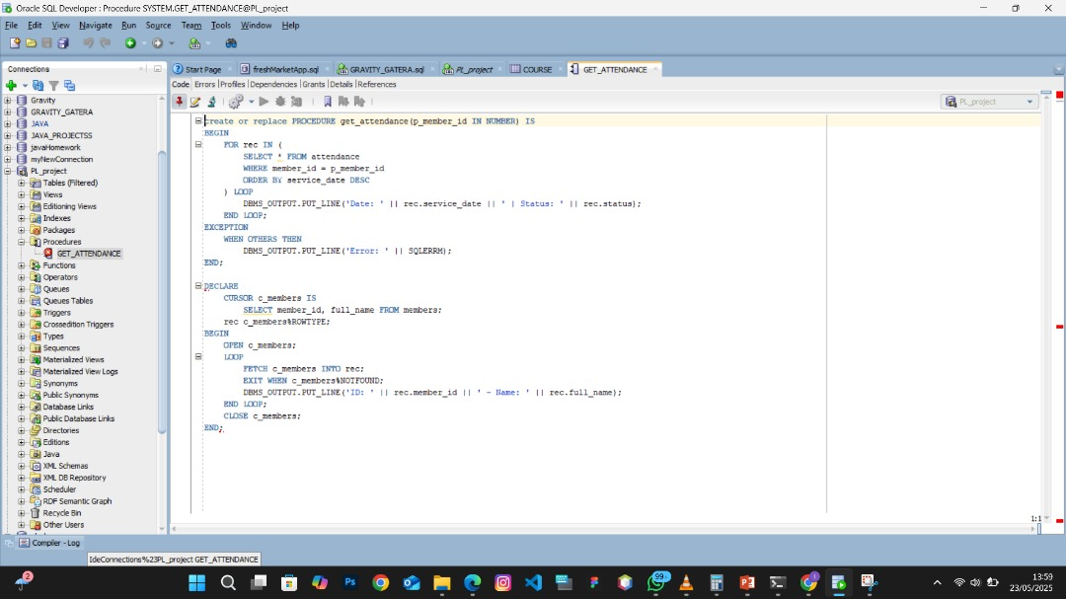
Procedures Created: update_attendance_status

Slide 5
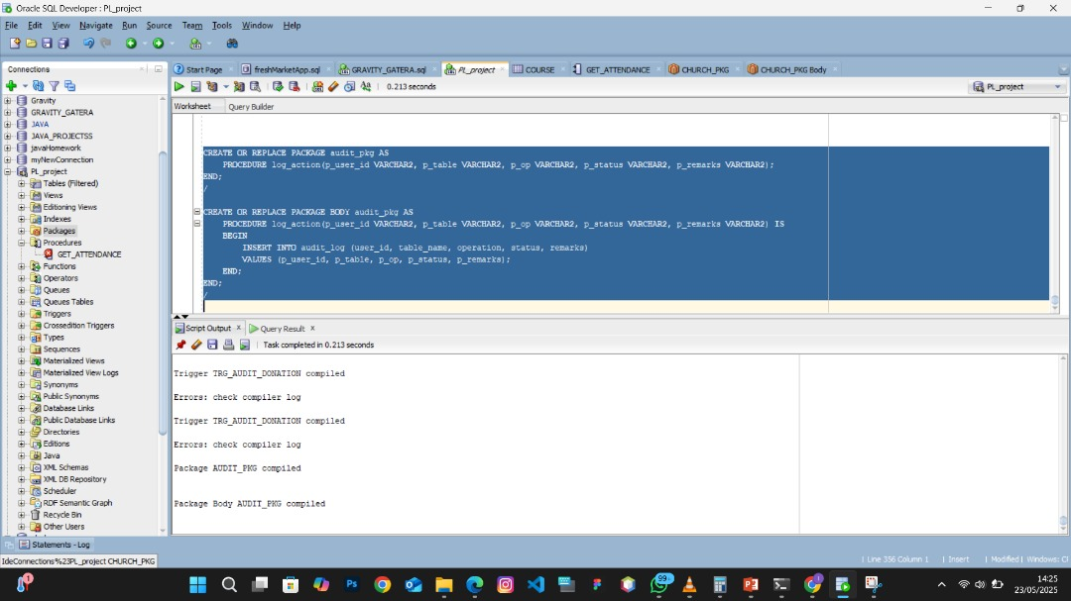

Slide 6
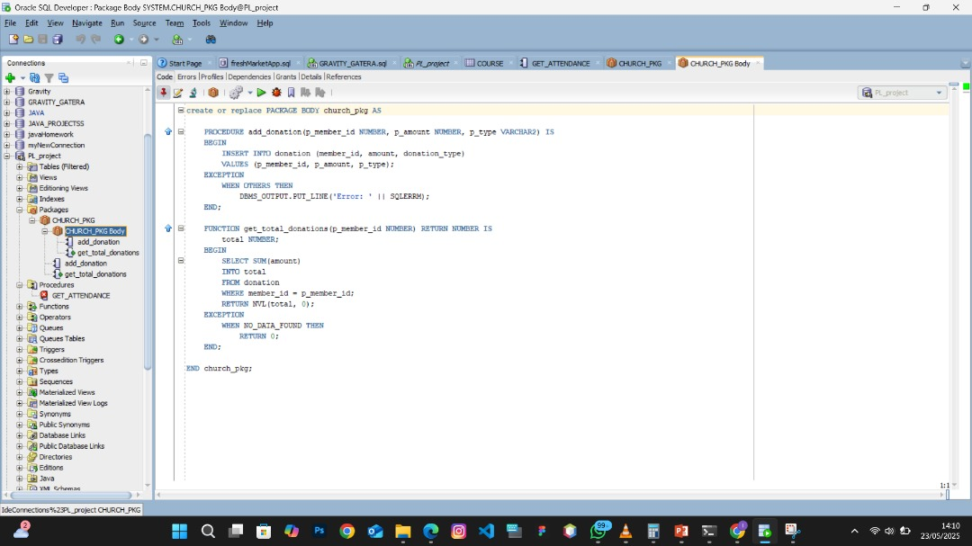

Slide 7
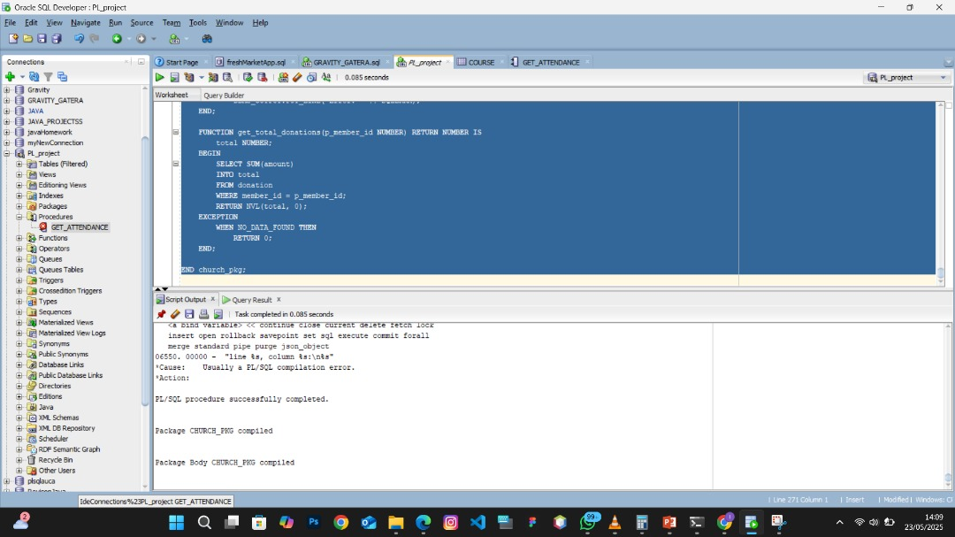

Slide 8
